Slide 1
Lending Club Case Study
Group Members: Sawan Sabbu Pramod Prasad

Slide 2
Introduction
Lending Club is a consumer finance marketplace for personal loans that matches borrowers who are seeking a loan with investors looking to lend money and make a return. It specialises in lending various types of loans to urban customers.

Slide 3
BUSINESS UNDERSTANDING
Lending Club company specialises in lending various types of loans to urban customers. When the company receives a loan application, the company has to make a decision for loan approval based on the applicant’s profile. Two types of risks are associated with the bank’s decision:
If the applicant is likely to repay the loan, then not approving the loan results in a loss of business to the company.
If the applicant is not likely to repay the loan, i.e. he/she is likely to default, then approving the loan may lead to a financial loss for the company.
The data given below contains information about past loan applicants and whether they ‘defaulted’ or not. The aim is to identify patterns which indicate if a person is likely to default, which may be used for taking actions such as denying the loan, reducing the amount of loan, lending (to risky applicants) at a higher interest rate, etc. When a person applies for a loan, there are two types of decisions that could be taken by the company:
Loan accepted: If the company approves the loan, there are 3 possible scenarios described below:
Fully paid: Applicant has fully paid the loan (the principal and the interest rate).
Current: Applicant is in the process of paying the instalments, i.e. the tenure of the loan is not yet completed. These candidates are not labelled as 'defaulted’.
Charged-off: Applicant has not paid the instalments in due time for a long period of time, i.e. he/she has defaulted on the loan.
Loan rejected: The company had rejected the loan (because the candidate does not meet their requirements etc.). Since the loan was rejected, there is no transactional history of those applicants with the company and so this data is not available with the company (and thus in this dataset)

Slide 4
Business Objective
Objective is to identify the risky loan applicants at the time of loan application so that such loans can be reduced thereby cutting down the amount of credit loss. Identification of such applicants using EDA is the aim of this case study.
In other words, to understand the driving factors (or driver variables) behind loan default, i.e. the variables which are strong indicators of default. The company can utilise this knowledge for its portfolio and risk assessment. And thus minimise the risk of losing money while lending to customers.

Slide 5
APPROACH
Data Understanding
. Refer data dictionary
. Data exploration
Data Handling
. Missing Values
. Data Types
. Derived Data
Data Visualization
. Univariate Analysis
. Bivariate Analysis
Conclusion
. Recommendations

Slide 6
Data analysis
Github code link- https://github.com/sawan121989/CaseStudy_LendingClub

Slide 7
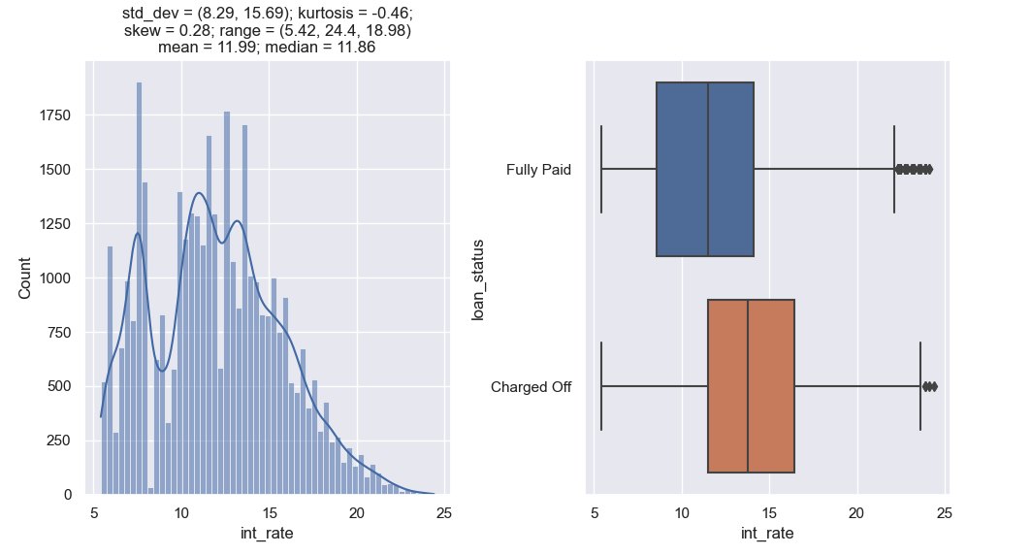
Interest Rate
There are no defaults for loans having less than 10% interest rate. Charged off loans have higher interest rates and histplot is left skewed.

Slide 8
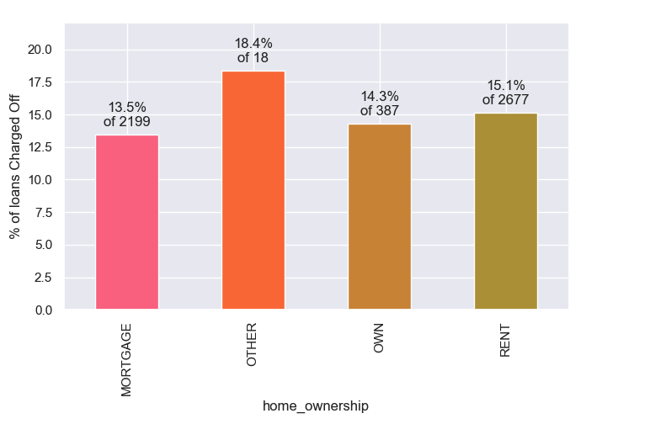
Home ownership
Borrowers who are "owning house” or “Mortgage” have lees probability for defaulting.

Slide 9
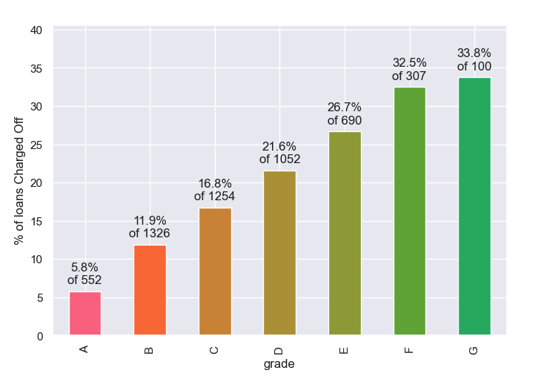
Grade
Grades- "F" & "G" are having very high risk of loan default.

Slide 10
Loan amount to Annual income ration
As long as loan amount is less than 20% of annual income, defaults are low.
Loan amounts for 30% of annual income or higher see a high rate of default.

Slide 11
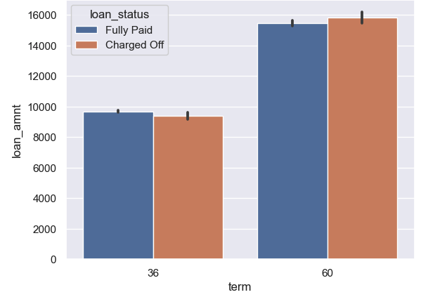
Loan term
Higher loan amount are associated with longer terms and see higher Charge Offs.

Slide 12
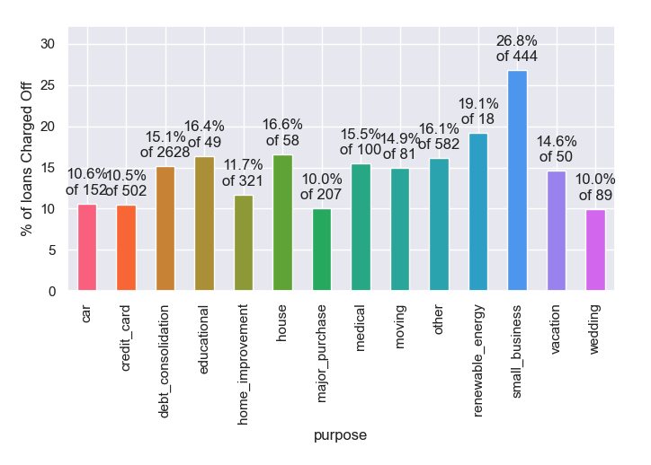
Loan Purpose
People having "small_business" are at high risk of loan default.

Slide 13
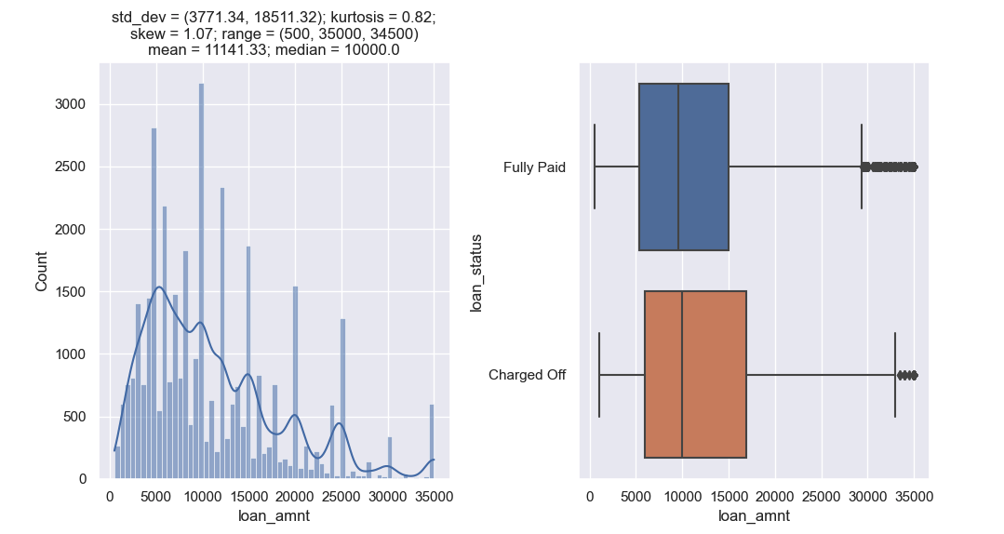
Loan amount
Smaller loan amounts less than 10,000 have lower chances of default.

Slide 14
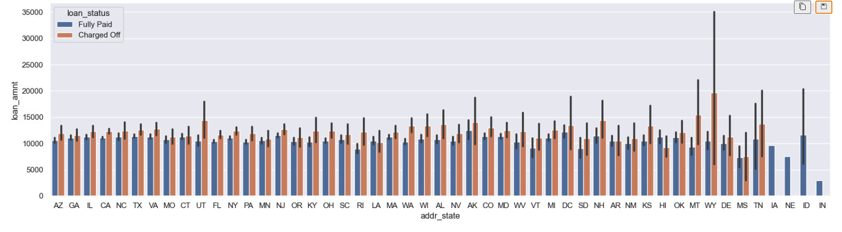
Address State
People having "small_business" are at high risk of loan default.

Slide 15
Recommendations
It was observed that there are no defaults for loans having less than 10% interest rate, hence Lending club should consider accepting more loans with less than 10% interest rate.
Lending club should consider to accepting more loans request for borrowers who are "owning house" as they have lees probability for Charged off.
Lending club should consider to accepting more loans request for grade A as it has just 5% Charge off loans. Other Grades have high Charge off probability.
Lending club should consider to accepting more loans request for borrowers which have loan amount less than 20% of their annual income.
Lending club need to accept more loan for 36 month term as they have less chances of Charged off.
Lending club need to accept loan for individuals owning house, loan amount less than 20% of their annual income and interest rate is less then 10%.This combination is have less chances to charged_off.
Lending club should accept more loan applied for wedding, major_purchase, car and credit_card as the chances of charged off is less(~10%) but for small business they should avoid as they have 26.8% charged off.
Lending club should accept the loan request for small loan amount.
Lending club should accept the loan request for coming from address state IN, IA and NE as they are having low risk of charged off.

Slide 16
Thank you

